Slide 1
MBUS853-2027 Digital Strategy and Transformation
Queen’s Accelerated MBA
Class Session 3: Digital Landscape
Salman A. Mufti, PhD
August 9, 2026

Slide 2
Course Topics: An Integrative Perspective
Digital
Landscape
Digital Strategy
Digital
Architecture
Digital
Leadership
Digital
Imple-
mentation
… and
Partnership
Digital
Renewal
Digital
Organization

Slide 3
Class Session 3: Digital Landscape
Examine the process of identifying and tracking emerging technologies. Discuss opportunities and challenges that companies face when considering their future in a fast-changing digital world.
Article: AI Won’t Give You a New Sustainable Advantage
Case: DeepSeek: The Emergence and Evolution of an AI Technology
Briefing: Strategic Decision Making (slides posted after the session)

Slide 4

Mini-Case: PulsePoint and Gen AI Salesbot
Jeannie Weiss had taken over as the CEO of PulsePoint Solutions, a Chicago-based digital marketing company, seven years earlier, shortly after its initial public offering. Under her leadership the business had grown its top line consistently year over year lifting annual revenues to $2 billion. Among investors, PulsePoint was a highly regarded growth stock, but some analysts were questioning how long the company, with its customized content and high-cost structure, could justify being less profitable than its peers.
“It’s so nice to feel excited about something again,” said Jeannie said to John Bart, her chief technology officer after an AI conference. The demos had convinced her that Generative AI Salesbots could revolutionize sales and customer service. “If a competitor pulls this off, we’ll be left in the dust.” John was cautious. “Hallucinations, data privacy, outages, these are all concerns,” he said, worrying about losing control of the technology. Still, he agreed to explore it. Three weeks later, John presented the idea to Mark Thompson, head of sales, and Linda Lau, chief customer officer. He argued the salesbot could “anticipate prospects’ needs and respond faster,” cutting costs while boosting satisfaction. “Modeling suggests we could reduce head count almost immediately through attrition and scale it back by as much as 30% over five years.”
Mark was skeptical. “Sales involve intuiting needs and recognizing hidden opportunities,” he warned. “Bots will close some deals, but we’ll miss out on upselling and cross-selling.” John countered, “These aren’t static machines. They learn… and might well outperform our most skilled professionals.” Linda saw both sides. “It feels like sci-fi,” she said, “but I’m worried about accuracy and what layoffs would do to our brand.” She also noted that more automation might increase client inquiries, not reduce them. Jeannie tried to frame it as a larger transformation: “Once this system is operational, it could automate content creation too. This isn’t just evolution, it’s revolution.”
Later that day came an unexpected call from Tyrell Durant, CEO of Orion, PulsePoint’s biggest client. “Jeannie, I heard from our sales rep that you’re considering introducing AI-enabled customer service, and I’m just telling you now that we want to be exempt from that. We’re traditionalists who value deep, personal client relationships. We also have a serious worry about data privacy and the potential mishandling of sensitive information. I’m sorry, but we can’t be part of this journey with you, at least not for the foreseeable future.” Jeannie faced a dilemma: risk PulsePoint’s hard-won relationships by leaping into a transformative technology, or risk irrelevance by waiting too long.
Question: What do you think Jeannie should do?
Source: A. Shrestha, Harvard Business Review (adapted and edited)
Notes:
Here are three distinct strategic paths Jeannie could take—each grounded in a different approach to balancing innovation, risk, and client trust:
1. Cautious Integration Strategy
Jeannie could pilot generative AI salesbots internally or in a limited segment—perhaps with smaller, less risk-averse clients—while maintaining human-led relationships for key accounts like Orion. This allows PulsePoint to learn, address reliability and privacy issues, and build internal confidence without jeopardizing its reputation. Over time, as performance and trust grow, the company can expand adoption.
Rationale: Preserves client relationships, manages risk, and positions the firm for gradual transformation rather than abrupt disruption.
2. Dual-Track Strategy
PulsePoint could create two parallel service models: a human-centric premium offering for clients like Orion who value personal relationships, and an AI-enhanced model for cost-sensitive or tech-forward clients. This segmentation allows the firm to pursue innovation and operational efficiency while retaining clients with traditional preferences.
Rationale: Enables differentiated positioning, caters to diverse client expectations, and buys time to refine the AI offering.
3. Transformational Leadership Strategy
Jeannie could take a bold stance and lead the market by fully adopting generative AI across sales and service, positioning PulsePoint as a pioneer in AI-driven marketing. To manage the fallout, she could pair this with strong communication about data governance, transparency, and retraining programs for affected employees.
Rationale: Seizes first-mover advantage, aligns with PulsePoint’s “growth stock” image, and signals strategic conviction—but carries higher risk to relationships and brand perception.
This case works quite well for introducing disruptive technology, especially if you distinguish disruption from simply adopting an impressive new technology.
In the Christensen sense, a disruptive technology is not necessarily one that is technologically superior at the outset. It often begins by being worse on dimensions valued by established customers, while being significantly better on other dimensions such as cost, convenience, accessibility, or scalability. Over time, as the technology improves, it can challenge the established way of competing.
That lens creates an interesting interpretation of PulsePoint:
GenAI may initially be inferior on PulsePoint’s traditional sources of value. Orion values personal relationships, trust, privacy, and human judgment. Mark similarly worries about understanding unstated needs, upselling, and cross-selling. On these dimensions, the Salesbot may initially underperform experienced salespeople.
But it could be dramatically better on a different performance trajectory. The Salesbot potentially offers much lower cost, faster response, 24/7 availability, scalability, and eventually automated content creation. These attributes become particularly important given PulsePoint's high-cost structure and profitability concerns.
The biggest customers may actually discourage adoption. Orion's response is particularly important. PulsePoint's largest client is effectively saying, don't give us this technology. This resembles the classic innovator's dilemma: listening carefully to today's best customers can rationally lead an incumbent to underinvest in something that could become important tomorrow.
The organizational resistance is rational, not simply resistance to change. Mark and Linda have legitimate concerns because they are evaluating GenAI against the requirements of PulsePoint's current business model and customers. John and Jeannie are implicitly evaluating it against what the future business model might become.
The real threat may come from a different competitor. Imagine a new digital marketing company built around AI from the beginning. It might initially serve smaller or more price-sensitive clients who are willing to accept less personalization in exchange for dramatically lower prices and faster service. As its AI capabilities improve, it could move toward PulsePoint's mainstream customers. That would be much closer to Christensen's classic disruption pattern.
This leads to what I think is the most useful teaching insight from the case:
The dilemma is not whether GenAI is better than people today. It is whether its different trajectory of improvement could eventually redefine what customers value and how the industry competes.
You could depict the case with a simple disruption diagram:
Traditional performance trajectory:
Human sales/service → high personalization, relationships, judgment → high cost
Emerging trajectory:
AI Salesbot → initially weaker relationships/judgment → low cost + speed + scale → improving capabilities → potentially sufficient or superior performance
There is also a useful nuance for students: GenAI itself is not automatically disruptive. If PulsePoint simply uses it to make its existing salespeople more productive, it is more accurately a sustaining innovation. It becomes potentially disruptive when it enables a different value proposition, cost structure, customer segment, or business model that can eventually challenge the existing model.
That distinction could generate a strong class question:
“Is PulsePoint facing a disruptive technology, or is it turning a potentially disruptive technology into a sustaining innovation?”
I think that question would work particularly well because there isn't an obvious answer. PulsePoint could augment its salespeople, replace substantial parts of the existing model, or even create a separate AI-first offering for customers who value cost, speed, and convenience over high-touch service. Those choices connect the technology directly to Christensen's core argument rather than treating “disruptive” simply as synonymous with “transformative.”

Slide 5
Disruptive Technology-Based Innovation
Demanding
performance
customers
A disruptive technology starts by serving customers that established companies tend to ignore, often with a simpler, cheaper and initially inferior solution (“cheap and bad”).
Initially it is adopted by new or underserved markets but then it improves fast enough to meet the needs of mainstream customers and eventually displaces the incumbents.
The disruption is not the technology itself, but the new business model and market it enables.
Progression of original
technology-based
innovation
Performance
customers
can absorb
Performance
Simple
performance
customers
Progression of
disruptive technology-based innovation
Time
Source: C. Christenson, The Innovator's Dilemma

Slide 6
Business-Digital Strategy (Revisited)
Business Strategy
What are we?
(or would like to be?)
Mission/Values/Vision/Objectives
Environmental/Competitive Analysis
Internal/Process/Customer Analysis
Internal/External Resources
Digital Technologies
What can we be?
Emerging Technologies
Informational Inventory
Technology Inventory
Technology Organization/Partners

Slide 7
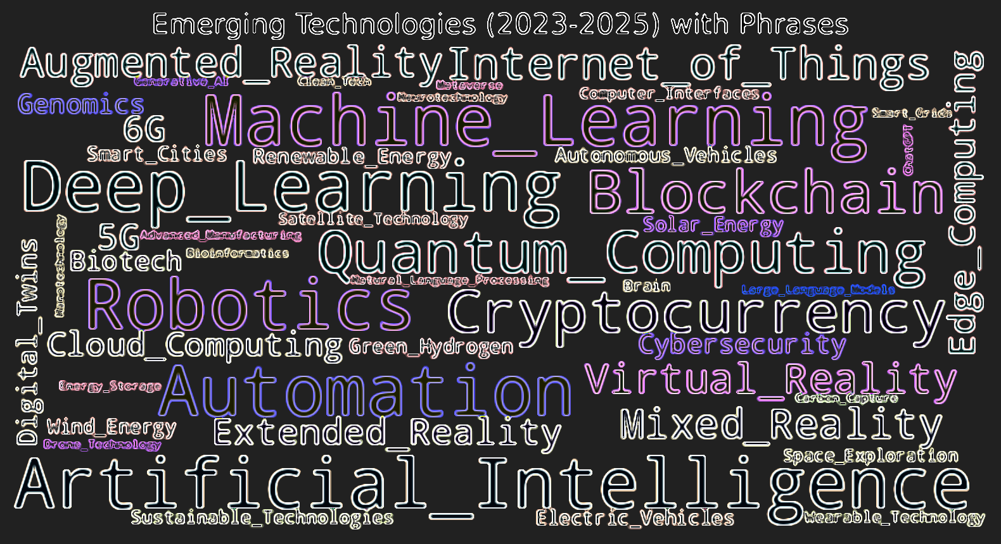
What is an Emerging Technology?
“Emerging Technology is a term generally used to describe a new technology, but it may also refer to the continuing development of an existing technology.”
“The term commonly refers to technologies that are currently developing, or that are expected to be [widely] available within the next five to ten years, and is usually reserved for technologies that are creating, or are expected to create, significant social or economic effects [positive and negative].”
Some Examples:
Agentic AI, Spatial Computing (VR/AR), Digital Twin, Edge Computing, Robotic Process Automation, Bioinformatics, Sustainable Technology, Brain-Computer Interface, Quantum Computing.
Source: www.winston.com

Slide 8
IMD’s Emerging Technology Trends for 2026
AI Beyond Automation: Generative AI shifts AI from automating tasks toward augmenting creativity, decision-making, innovation and new business models.
Quantum Computing: Moving toward practical applications in areas such as drug discovery, financial optimization and complex logistics.
Next-Generation Cybersecurity: AI-driven security, zero-trust architectures (always verify), and quantum-resistant encryption strengthen organizational resilience.
IoT and Connected Ecosystems: Connected devices and AI enable organizations to sense, analyze and respond to operations and customers in real time.
Robots Redefining Work: AI-enabled robots expand beyond manufacturing into logistics, healthcare, agriculture, and customer-facing activities.
Green and Climate Technologies: Technologies such as energy storage, carbon capture, precision agriculture, and circular materials support sustainability and business opportunities.
Overall, emerging technologies are moving from experimentation to execution, creating organizations that are increasingly intelligent, connected, automated and sustainability-driven.
Source: https://www.imd.org/blog/digital-transformation/emerging-technologies/ (edited)

Slide 9
Question
How do you identify and assess the relevance of an emerging technology for your industry and organization?
Notes:
Enough to ask the right questions and make informed decisions.
A leader doesn’t need to code or architect systems but should understand how digital technologies create value, what risks they introduce, and how they shape strategy. The goal is digital literacy, not technical mastery.
Enough to bridge the gap between business and technology teams.
Effective leaders can translate strategic goals into technology priorities and vice versa. They recognize when a proposal is visionary versus unrealistic, and they can challenge both technologists and business managers with equal confidence.
Enough to lead cultural and organizational change around digital.
The most successful leaders grasp that digital transformation is less about tools and more about shifting mindsets, data-driven decision making, and cross-functional collaboration. Their knowledge must help them inspire, not just implement.

Slide 10
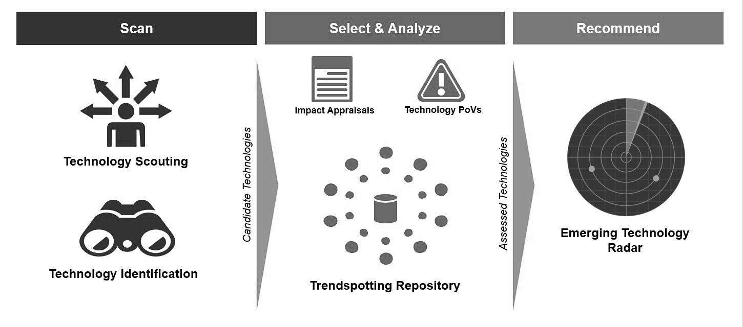
Establishing an Emerging Technology Radar
Source: Gartner Group

Slide 11
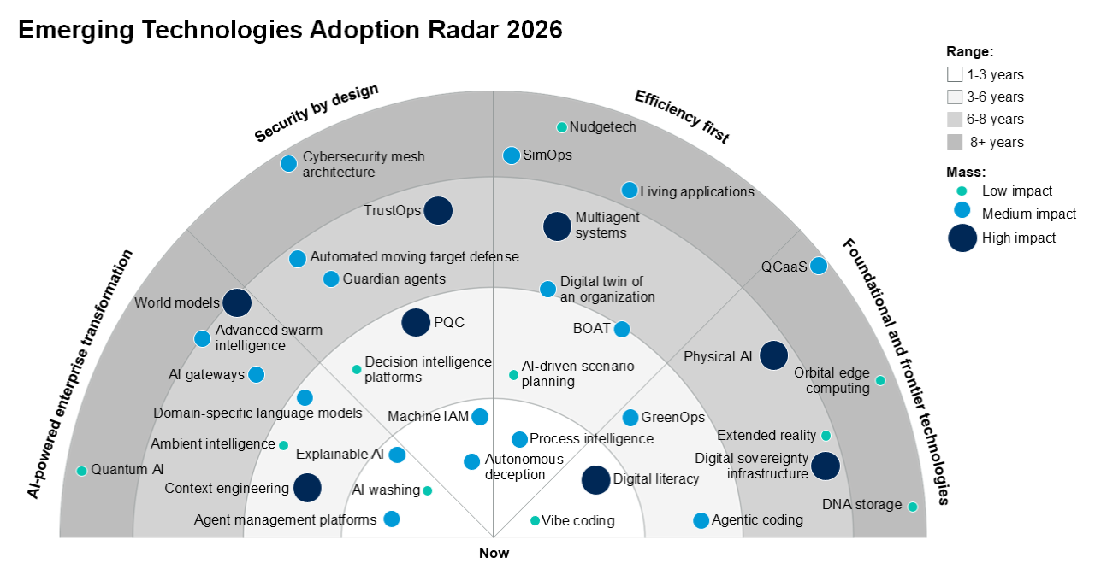
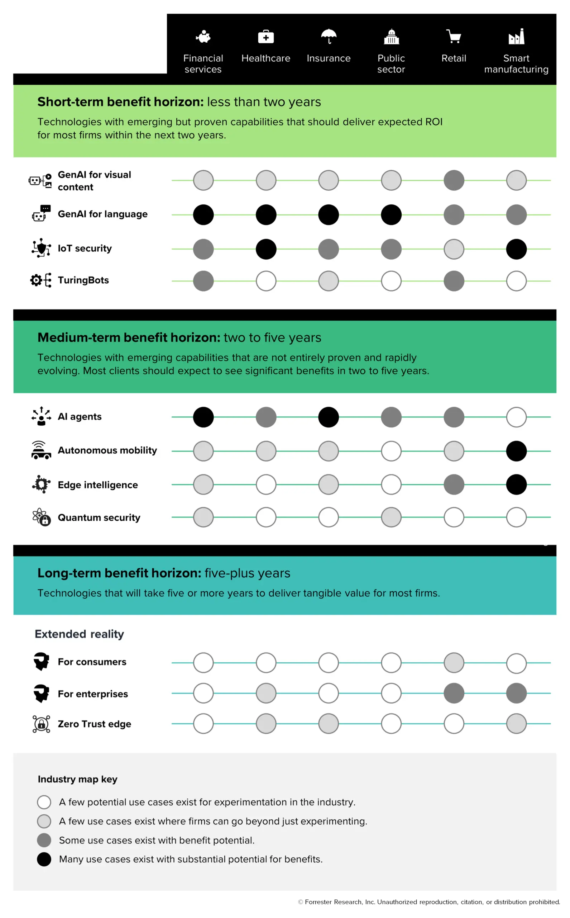
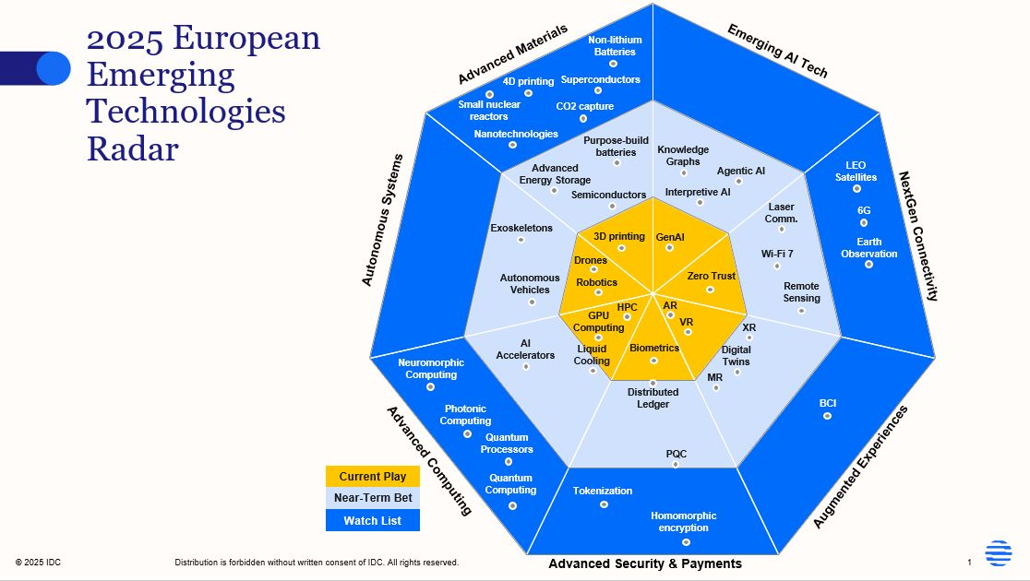
Emerging Technology Radars
Queen’s University students can access Gartner Gateway Service via signing into http://queensu.service-now.com and searching for “Gartner”
Gartner
Emerging technology radars from research firms help business leaders see which technologies are maturing, which are still experimental, and where real business adoption is starting to occur.
Their main purpose is not to predict winners, but to support conversations about opportunity, timing, risk, and where organizations should explore or wait.
Forrester
IDC
Source: Gartner Group 2026, Forrester 2024, IDC 2025

Slide 12
The Hype Cycle
Framework that illustrates how expectations for new technologies evolve over time
Visibility/Expectations
1. Technology
trigger
2. Peak of
inflated
expectations
3. Trough of
disillusionment
4. Slope of
enlightenment
5. Plateau of
productivity
Time
Source: Gartner Group

Slide 13
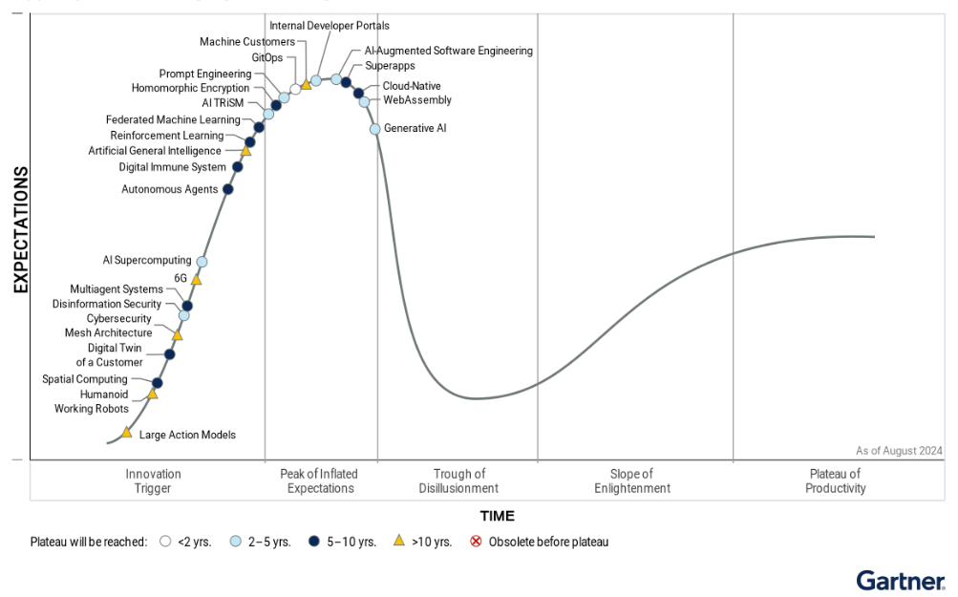
Hype Cycle of Emerging Technologies, 2024
2024 Themes: Autonomous AI, Boost Developer Productivity, Empower With Total Experience, Human-Centric Security and Privacy
Generative AI
Source: Gartner Group

Slide 14
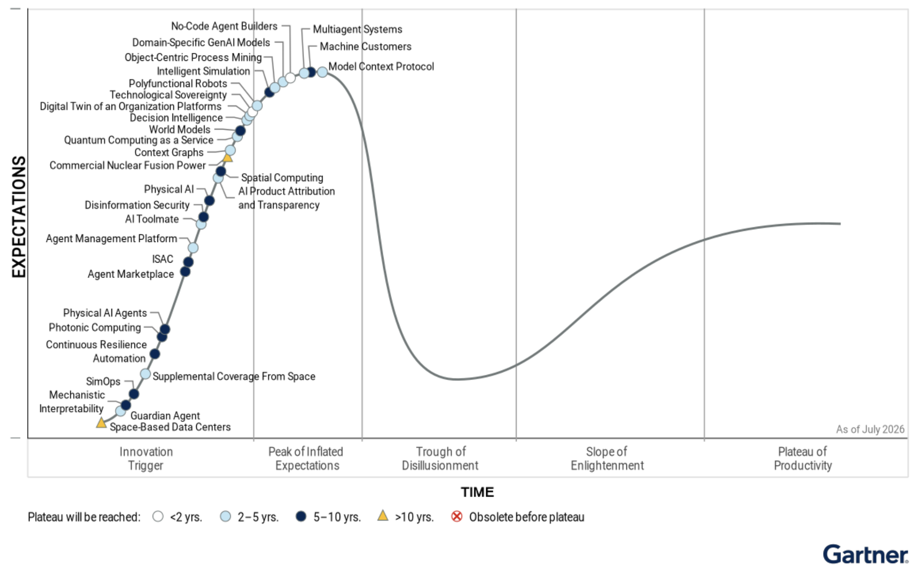
Hype Cycle of Emerging Technologies, 2026
Multi Agent Systems
2026 Themes: Autonomous Business, Hypermachinity, Augmented Humanity and Techno-Societal Fragility
Digital Twins
Quantum Computing
Spatial Computing
Space-Based Data Centers
Source: Gartner Group

Slide 15
Premises and Advice for Emerging Technologies
Diffusion and Adoption
  Each emerging technology will diffuse at a different rate and pace depending on industry and region. Judge adoption by context.
Triangulation for Insights
  Different research approaches and perspectives are needed, instead of conventional and convergent thinking. Always consult multiple sources.
From Hype to Understanding
  Important to move beyond hype and connect a technology to business value, risks and implications. Structure thinking with a framework or checklist.
Exploration and Learning
  Learning in organizations will take place from series of experimentation and trials. Test, learn and optimize.
Source: G. Day et al, Wharton on Emerging Technologies (edited)

Slide 16
Article: AI Won’t Give You a New Sustainable Adv.
What’s the article about? What’s your insight? What’s your critique?
Generative AI creates value for everyone, but its widespread adoption makes it hard to sustain a unique competitive advantage.
Early adopters may see short-term gains, but their actions may help improve outcomes for slower-moving competitors as well.
Proprietary datasets can offer an edge, but similar datasets often produce similar insights, limiting significant differentiation.
Building custom Generative AI tools may help briefly, but others can quickly replicate or improve on your solution.
Generative AI can strengthen existing, hard-to-imitate capabilities, but alone, it won’t create new long-term advantages.

Slide 17
MIT Report on GenAI Implementation 2025
The report, GenAI Divide: State of AI in Business 2025, is published by MIT’s NANDA initiative. It draws on 150 executive interviews, a survey of 350 employees, and an analysis of 300 publicly-announced generative AI deployments (https://mlq.ai/media/quarterly_decks/v0.1_State_of_AI_in_Business_2025_Report.pdf).
In large companies, about 95% of GenAI pilots fail to deliver measurable revenue impact.
Startup companies and a few large company pilots excel, mainly by focusing on one pain point and partnering smartly.
Failures stem from a learning gap in enterprise integration, not AI model performance or regulation.
Shadow AI use is widespread, with employees adopting unsanctioned tools like ChatGPT.
Purchased vendor solutions outperform internal builds (~67% vs. ~33%), especially in large companies.
Biggest ROI appears in back-office automation, while most budgets still flow to sales and marketing tools.
Source: Fortune Magazine (https://fortune.com/2025/08/18/mit-report-95-percent-generative-ai-pilots-at-companies-failing-cfo/)

Slide 18
Emerging Technology (ET) Adoption
1. Identify the specific business problems, bottlenecks, or organizational needs you want to address. This stage defines your acceptable risk level and what success looks like
5. Communicate the pilot's success and the technology's long-term business value to stakeholders at all levels of the organization. This drives internal buy-in and funding
Innovative ET
candidates
1. Scope
5. Evangelize
3. Analyze and compare the short-listed candidates. Weigh the pros, cons, costs, and risks
4. Pilot the higher-ranked technologies. This builds concrete proof-of-concept data
3. Rank
4. Evaluate
2. Track
6. Transfer
2. Research and identify potential technologies or vendors that align with your scope. Teams look at market intelligence to determine a technology's maturity and its applicability to real-world use cases
6. Hand the successfully vetted technology over to the permanent operational or IT teams responsible for managing and supporting it in production
Source: J. Fenn & M. Raskino, Mastering the Hype Cycle (STREET Framework)

Slide 19
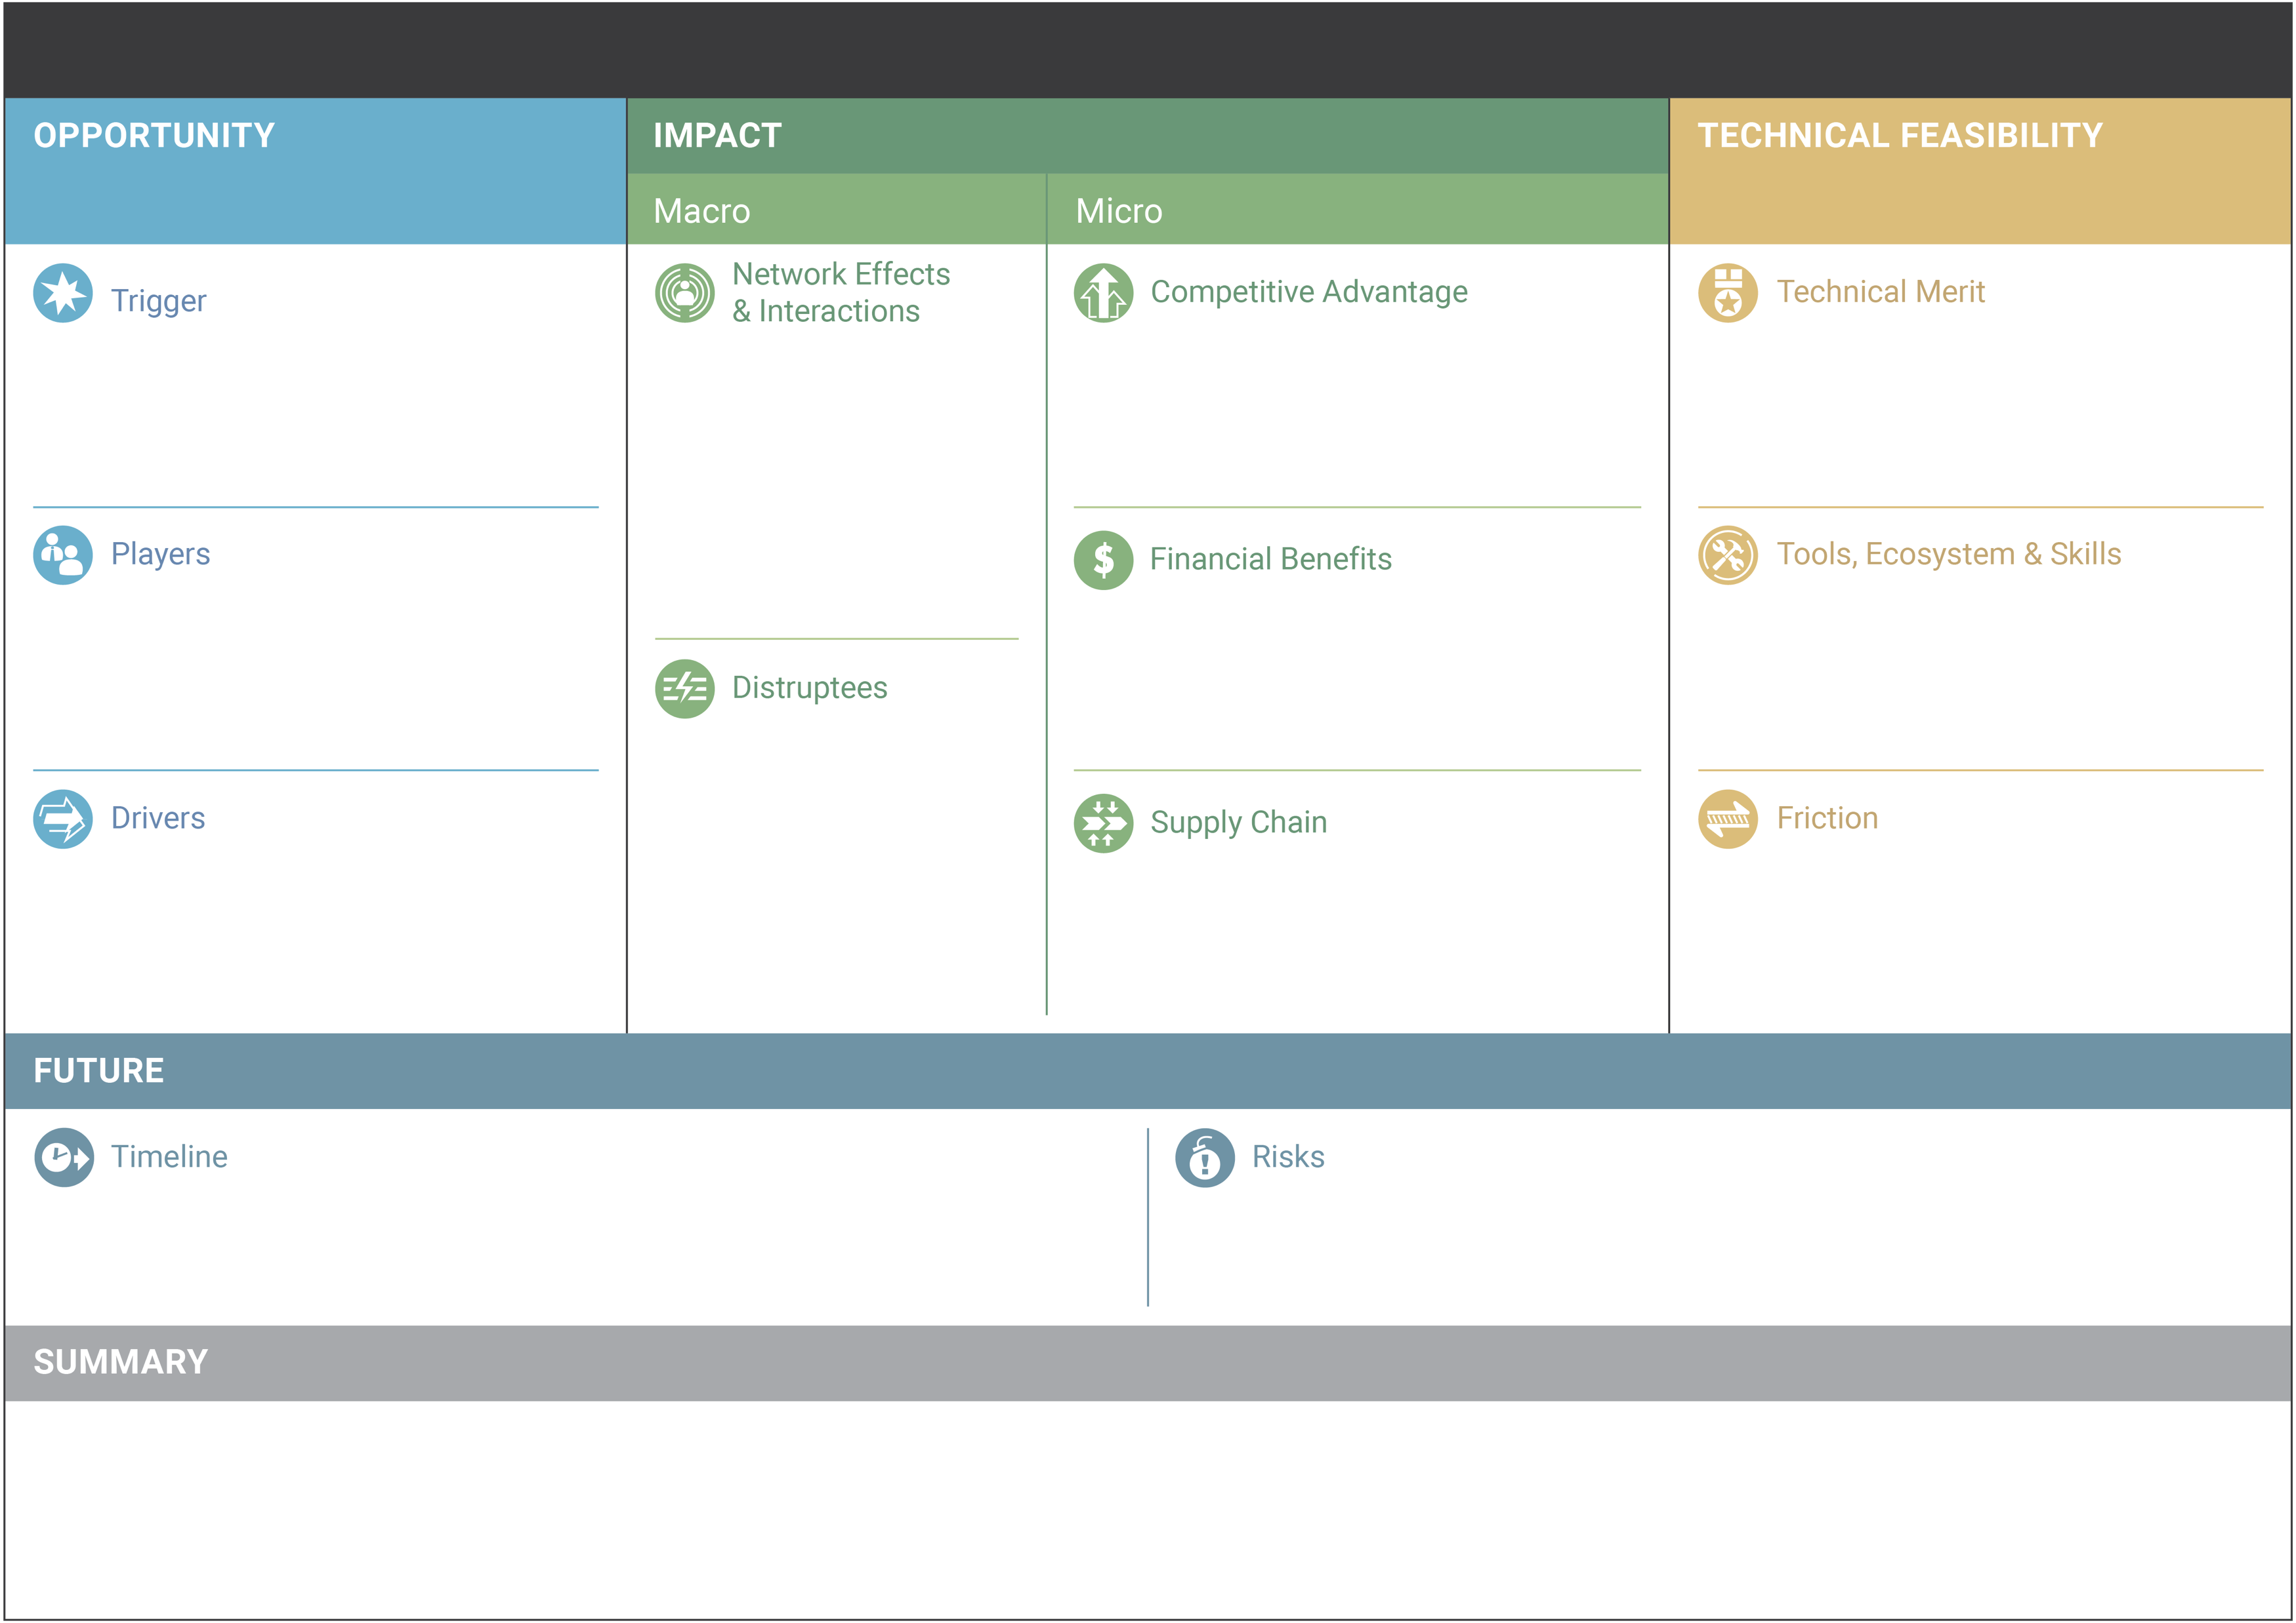
Emerging Technology Analysis Canvas (ETAC)
What is the event that provided the technological breakthrough?
What are the technical improvements taking place?
What is the speed and potential scale of the market?
How might the technology affect competitiveness in industry?
Which companies are researching and developing the technology?
How might the technology impact revenue and/or costs?
What are the associated tools and platforms, and the skills needed?
Which industries might be affected, positively or negatively?
What are the environmental factors that are helping the technology develop?
How would the technology affect customers, suppliers, partners?
What are the technical hurdles in deploying the technology?
What are the expected milestones in the technology’s development? How long will it take for the technology to be adopted by the intended customers?
What are the business and societal risks that might limit the technology’s deployment?
What are the key insights and the recommendation?
https://github.com/wso2/ETAC/blob/master/ETAC.md

Slide 20
ETAC Example: Blockchain (Draft v1)
For illustrative purposes only
Bitcoin 2008 (Whitepaper); launched 2009
Early adoption (finance, logistics), gradual expansion (healthcare, gov’t).
Efficiency, transparency and trust, transaction speed.
Scalability enhancements, energy efficiency, interoperability, security.
IBM (leader), Microsoft, Amazon (AWS), FB/Meta Ethereum, JPMorgan Chase.
Reduced transaction costs, improved cash flow, reduced fraud.
Ethereum (dApps), Hyperledger (Linux), Binance (Smart Chain).
Positively: Financial services, logistics, healthcare, energy, real estate. Negatively: Traditional intermediaries such as banks, brokers, legal.
Need for trust, new regulations, advancements (cloud/AI), economic (reduced costs).
Increased visibility, improved privacy/security, user experience.
Energy usage, network silos, network security, data integrity.
Widespread adoption of Ethereum (3-5 years), Cross-chain interoperability (3-5 years), Regulatory clarity (4-7 years).
Technological (security, scalability), Regulatory (in flux, global compliance), Operational (integration).
Blockchain is not limited to the financial industry; it has the potential to revolutionize a wide range of sectors, mainly from a cost efficiency perspective. Widespread adoption is complex and dependent on numerous factors (regulatory, technical standards, user/privacy acceptance). Don’t wait long to invest; find an appropriate use case and pilot the technology for a business application.

Slide 21
Organizational Structure for Emerging Technologies
Build a cross-organization innovation council which has membership from all business units.
Make customer centricity and product/service/experience improvements as the core component of all experiments.
Create a structure to generate ideas and initiate experimentation from all business units.
Create a governance model to ensure smooth review, approval and execution of all approved ideas.
Source: https://www.linkedin.com/pulse/innovation-experimentation-essential-digital-fawad-khan/

Slide 22
Organizational Process for Emerging Technologies
Before you start an experimental project make sure that you have clearly identified a business or a customer problem you are trying to solve.
Experiments usually don't have a formal budget associated with it and thus you are forced to use existing resources available to you or anything else you can find at no or minimal cost to create your proof-of-concept.
This is where you need to remember that you are not looking for perfection when you are experimenting but rather you should aim for agility to get the Minimal Viable Product (MVP) out the door as soon as possible.
Source: https://www.linkedin.com/pulse/innovation-experimentation-essential-digital-fawad-khan/

Slide 23
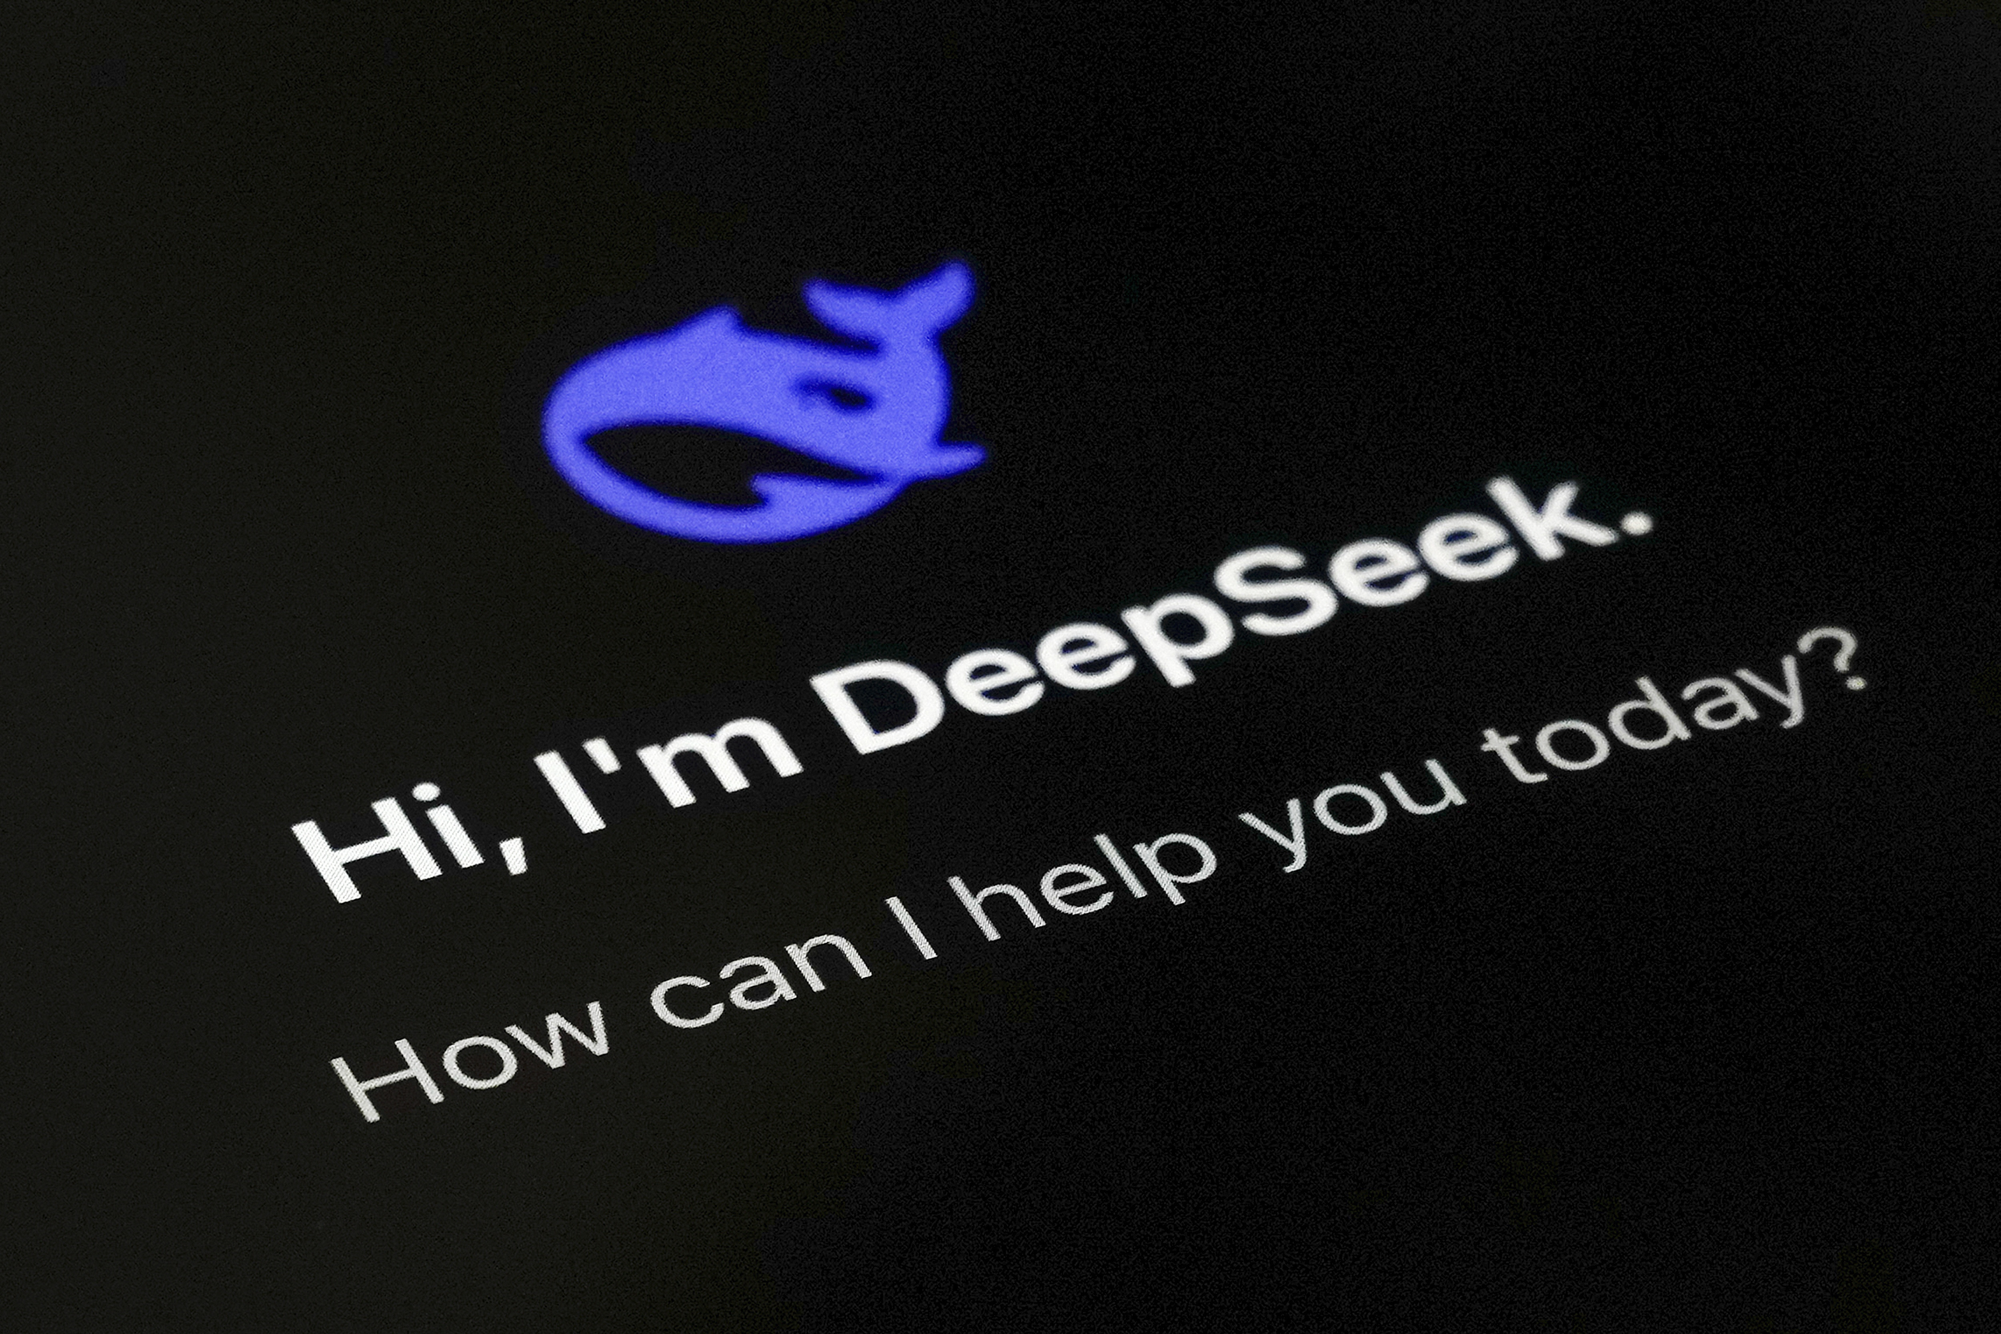
Case: DeepSeek
What do we know about DeepSeek from the case study?
Is DeepSeek an example of disruptive innovation?
What were the issues facing DeepSeek?
What is your going-forward recommendation?

Slide 24
Case Debrief
Digital Innovation is not just about having more resources but using resources differently. DeepSeek challenged one of the core assumptions of the AI industry that the best models require the largest budgets, newest chips, and greatest computing power. Instead, it demonstrated that architectural innovation, efficient training methods, and data curation could achieve comparable performance at dramatically lower cost. This shifted the basis of competition from scale to ingenuity. Constraints often stimulate innovation. Lesson: Competitive advantage can come from rethinking assumptions rather than simply investing more.
Technological success alone is not enough; sustainable advantage requires an enduring business model. DeepSeek achieved technical credibility and global adoption through its open-source strategy. But same openness created important challenges: monetization, intellectual property protection, commoditization, geopolitical restrictions and security concerns. The question shifts from asking How did DeepSeek disrupt? to How can DeepSeek sustain its success? Lesson: Creating a breakthrough technology is only the beginning. Long-term success depends on developing a scalable business model and building a defensible competitive advantage.

Slide 25
Effects of Technology in Organizations and Industry
Historically, technologies have evolved from improving existing business processes to fundamentally reshaping how organizations create value. This evolution often goes through three increasingly transformative effects:
Substitution Effect: Digital technologies create value by replacing existing products, services, processes or channels with more efficient digital alternatives.
Scale Effect: Digital technologies create value by enabling organizations to reach significantly more customers, markets or activities with relatively little additional cost.
Structural Effect: Digital technologies create value by fundamentally redesigning how organizations create, deliver and capture value, often reshaping industries and ecosystems.
Source: H. Lee, Stanford University

Slide 26
Effects of AI on Business and Industry
Effect | Question to Ask | Organizational Change
Substitution | What parts of our business could AI replace or automate? | Don't simply digitalize existing processes. Determine which activities, products, services or channels no longer need to exist in their current form.
Scale | How can AI allow us to serve many more customers or employees at much lower cost? | Think beyond efficiency. Use AI to expand reach, improve consistency and increase organizational capacity without proportional increases in resources.
Structural | If AI changes the economics of our industry, how should we redesign our business? | The biggest opportunity is often not automation, but rethinking organizational structure, value creation, partnerships and competitive positioning.

Slide 27
Digital Landscape Takeaways
We tend to overestimate an emerging technology’s potential in short run but often underestimate it in the long run. An emerging technology often disappoints in the short run before becoming productive. Always consider the context, research multiple sources, link it to business understanding, and experiment to learn.
Don’t seek and chase advantage in the technology itself. An emerging technology will likely and soon be widely available, so focus less on adopting it first for the sake of it, and more on how it reinforces what the business already does better than competitors. Use it to strengthen hard-to-copy capabilities.
Source: https://www.linkedin.com/pulse/innovation-experimentation-essential-digital-fawad-khan/

Slide 28
Reflections Journal and Next Class
Please be sure to write your Reflections Journal entry for Session 3
  Reflect and write on ONE key concept from the class session slides (not from the assigned article, case study, or any external sources) and the application of that concept through ONE specific example from your professional experience or personal observation (not from the assigned article or case study).
Session 4: Digital Organization
  Article 4: Building the AI-Powered Organization
  Case 4: Pernod Ricard: Uncorking Digital Transformation
    Team Case Memo Due Thursday before Class Weekend

Slide 29
Three “Laws” of Digital Technologies
Communications
Technology
Bandwidth Access
Moore’s Law: Computing power per dollar roughly doubles about every 18 to 24 months.
Roberts’ Law: Bandwidth available to users in communication networks per dollar roughly doubles every 18 to 24 months.
Kryder’s Law: Data storage density per dollar roughly doubles every 18 to 24 months.
Roberts’ Law
These three “laws” indicate digital technologies do not improve incrementally; they improve exponentially. Working together they are accelerating the pace of change in business.
Computing
Technology
Processing Power
Content
Technology
Data Storage
Moore’s Law
Kryder’s Law

Slide 30
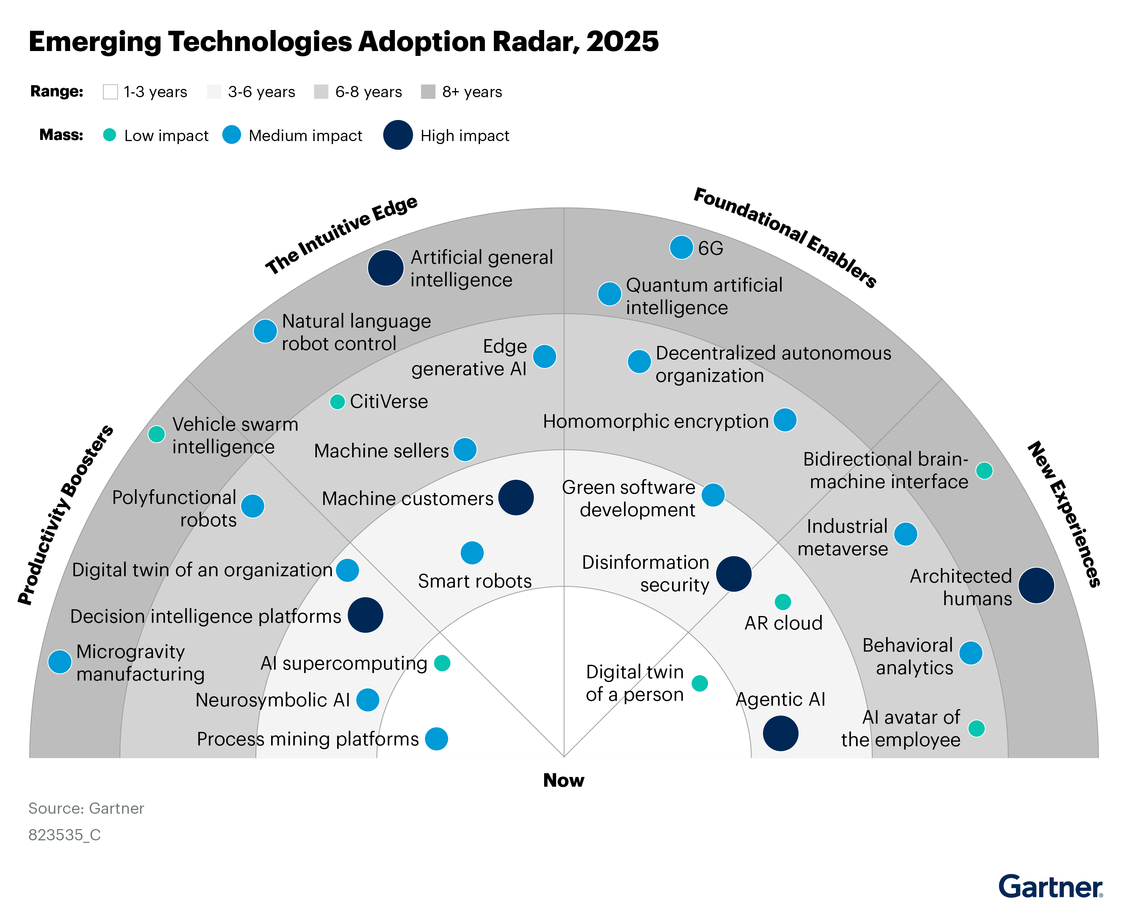
Emerging Technologies Adoption Radar, 2025
“Decision intelligence platforms and polyfunctional working robots will contribute toward the optimization of enterprise workflows, improve the speed of delivery of complex decisions, enhance the employee experience and support the reduction of manual intervention.
Smart robots, machine customers and edge generative AI (GenAI) will support the creation of a smarter world for enterprises to operate more autonomously and efficiently.
Green software engineering and disinformation security will provide the foundational enablers to support the enterprise to safely navigate the digital future and enhance risk management.
Industrial metaverse, architected humans and augmented reality (AR) cloud will offer new experiences for employees and customers to engage in the world around them.”
Source: Gartner Group

Slide 31
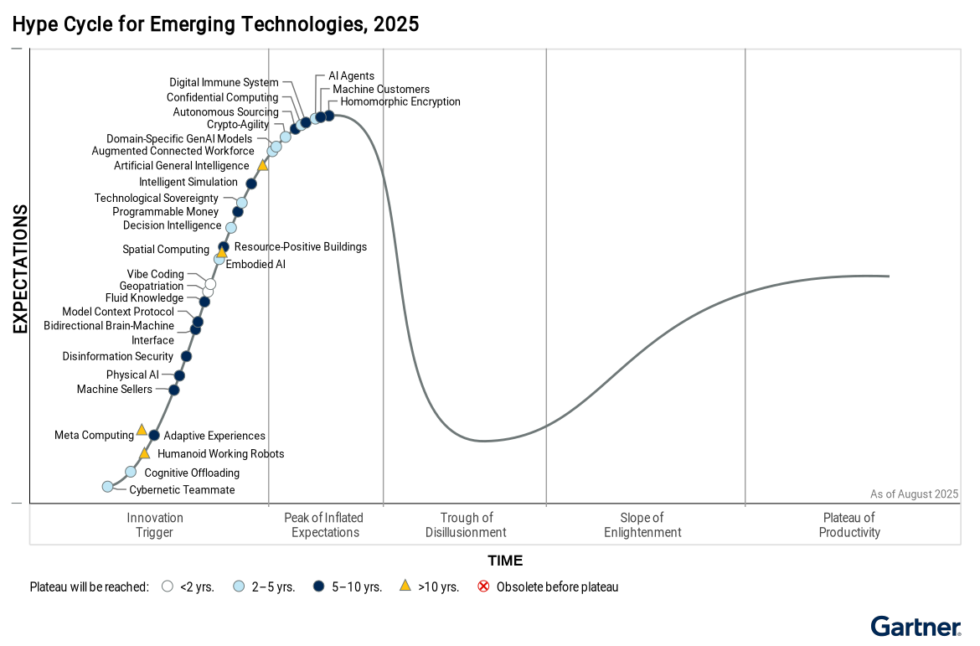
Hype Cycle of Emerging Technologies
2024
2025
2024 Themes: Autonomous AI, Boost Developer Productivity, Empower With Total Experience, Human-Centric Security and Privacy
2025 Themes: Autonomous Businesses, Hypermachinity, Augmented Humanity, and Techno-Societal Fragility
Source: Gartner Group

Slide 32
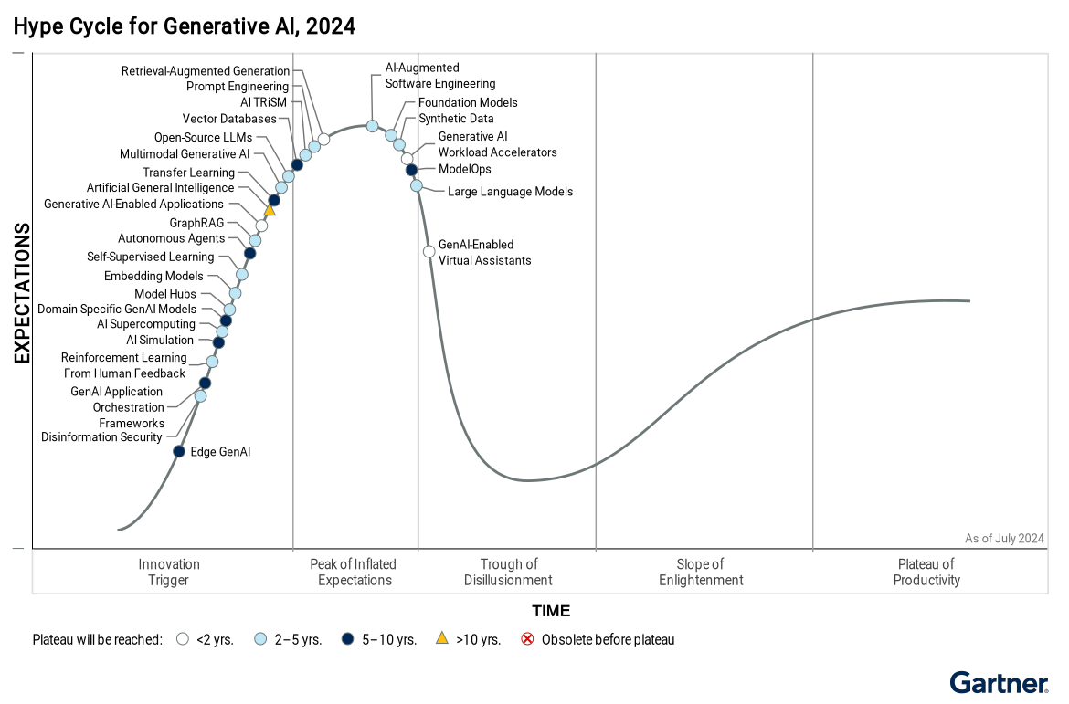
Hype Cycle for Generative AI, 2025
Generative AI (GenAI) is expanding rapidly across models, tools, and infrastructure, but most technologies remain early in the maturity cycle.
Early adoption of GenAI offers advantage, though many innovations face hype, risks, complexity, and implementation challenges.
Domain-specific and edge (locally-run) models are emerging as viable alternatives to general-purpose LLMs, offering better accuracy and privacy.
“By 2026, more than 80% of enterprises will have used generative AI APIs or models, and/or deployed GenAI-enabled applications in production environments, up from less than 5% in 2023.”
Source: Gartner Group

Slide 33

Case: Apple
Apple had planned to ship an AR Headset (N301) in 2022, and AR Glasses (N421) in 2023.
Why was Apple making such a big bet?
What were Apple’s competitors doing in the AR space?
How reasonable were Apple’s expectations? What were the key issues?
What could Apple do to win the AR war? What is your recommendation?

Slide 34

What is the Apple Vision Pro Really For?
On June 5, 2023, to great fanfare, Apple announced a new computer. The Vision Pro is a computer that is worn on your face, but the novel aspect is how you use it. Rather than view the computer’s output through a physical screen, that output is projected directly into your eyes with two very small but high-resolution displays a very small distance in front of you. Rather than control the computer through a keyboard, mouse, or touch screen, the primary user interface is through eye tracking and gestures.
Just as they removed the stylus for screens when they launched the iPhone, Apple requires no physical controller to use the computer. The computer senses what you are interested in interacting with by watching your eye movement and then looks at your hands to determine what you want to do.
Apple has termed this new device a Spatial Computer. The name is apt, because the device can use any physical space around you as a canvas to display digital outputs. There is no need for a desk (or lap) to place the device, and there are no limits on the size of the perceived viewing area. That means you could technically sit in a small space, like an airplane seat, and watch a cinema-sized movie.
Whether this device can lead to the augmented and virtual reality applications would justify strapping a computer to your head. It certainly has the technical capabilities to do so. The Vision Pro can display 3D objects in your current space or even transport you to new spaces. This is clearly an augmented and virtual reality device. Apple, however, barely mentioned the terms Augmented Reality (AR) and Virtual Reality (VR) during their announcement.
According to Apple, this is no AR or VR device or technology.
Source: J. Gans & A. Nagaraj, Harvard Business Review

Slide 35
Why Every Organization Needs an AR Strategy
Augmented Reality (AR) and Strategy
What is the range of AR opportunities in the industry, and in what sequence should they be pursued?
How will AR reinforce a company’s product differentiation?
Where will AR have the greatest impact on cost reduction?
Should the company make AR design and deployment a core strength, or will outsourcing or partnering be sufficient?
How will AR change communications with stakeholders?
Deploying AR (in the Value Chain)
Which deployment capabilities will be required?
How should organizations create digital content?
How will AR applications recognize the physical environment?
What AR hardware is required?
Should you use a software-development or content-publishing model?
Source: M. Porter & J. Heppelman, Harvard Business Review

Slide 36
Lessons from Big-Tech CEOs
How were these three very different leaders (Bill Gates: Microsoft’s pragmatist technocrat, Andy Grove: Intel’s disciplined engineer, Steve Jobs: Apple’s visionary perfectionist) able to steer their companies through the volatile ups and downs of decades of changing technologies? What did they have in common? What can we learn from them about successful strategy?
  Look Forward, Reason Back
  Make Big Bets, Without Betting the Company
  Build Platforms and Ecosystems—Not Just Products
  Exploit Leverage and Power—Play Judo and Sumo
  Shape the Organization around Your Personal Anchor
Source: D.B. Yoffie and M.A. Cusumano, Strategy Rules: Five Timeless Lessons from Bill Gates, Andy Grove, and Steve Jobs

Slide 37
Effects of Technology on Industry and Society
Substitution
  This effect is about replacing an existing product, service or distribution channel with a new technology-enabled one. An example is e-commerce.
Scale
  This effect is about doing a lot more (of the same) with new technology by aggregating services or markets. Perhaps an example is a platform business model.
Structural
  This effect is about doing things very differently or doing very different things, leveraging new technologies. Perhaps an example is a platform or ecosystem business model.

Slide 38
Substitution, Scale, Structural Effects and Models
Supplier
Manufac-
turer
Distributor
Retailer
Consumer
Supplier
Buyer
Mediator
Supplier
Buyer
Supplier
Buyer
Supplier
Buyer
A combination of the substitution and scale effects and other approaches to disrupt the industry value chain are creating new structural business models.

Slide 39
From Pipelines to Platforms
For decades, the Five-Forces Model of Competition has dominated the thinking about strategy. But it describes competition among traditional “Pipeline” businesses, which succeed by optimizing the activities in their value chains, most of which they own or control.
“Platform” businesses that bring together consumers and producers, require a different approach to strategy. The critical asset of a platform is external—the community of members. The focus shifts from controlling resources to orchestrating them, and firms win by facilitating more external interactions and creating “network effects” that [scale quickly and] increase the value provided to all participants.

Slide 40
Digital Landscape Takeaways
We tend to overestimate an emerging technology’s potential in short run but often underestimate it in the long run. Emerging technologies often disappoint in the short run before becoming productive. Always triangulate (research multiple sources) when assessing any new technology.
Technology adoption isn’t driven by an emerging technology alone. It depends on solving real business problems, building platforms and partnerships, and launching when the supporting infrastructure, applications and customer readiness align.

